Slide 1
Technology Break-Throughs and Business Opportunities
St. Francis University
March 30, 2012
Bill Hall, Director
billhall@rtto.psu.edu
814 933 8203

Slide 2
Shale Gas Innovation & Commercialization Center
Goals & Objectives:
Discover, encourage and support translational research and technological developments in small companies
To benefit the growth of the shale gas play in Pennsylvania in an environmentally sound manner
Create jobs for the citizens of the Commonwealth

Slide 3
Timeline of events
March 2011 Shale Gas Innovation and Commercialization Center born
June 2011 Kicked-off study on Marcellus shale gas industry needs with ADI Analytics
July 2011 Co-sponsored gas utilization workshop and Organized investor social hour
September 2011 Co Sponsored Innovation EXPO at Insight 2011 and Awarded 2 winners including Nittany Extraction Technologies
October 2011 Kicked-off $50K Innovation Contest, with major donor BFTP but with 5 industry sponsors - critical for verification of ideas
November 2001 Innovation Workshop with 6 panelists and 20 research presentations, and 50 participants

Slide 4
TimeLine of Events Continued
November 2011 Co-sponsored shale gas monetization study
December 2011 Presented at Stripper Well Consortium
February 2012 Presentation at Indiana County MSC Event
March 2012 Presentation at St Francis outreach event
May 2012 Presentation at Erie MSC event
May 24, 2012 Innovation Contest Award Event
September 5 and 6, 2012 Utilization Conference – Transportation and GTL focus

Slide 5
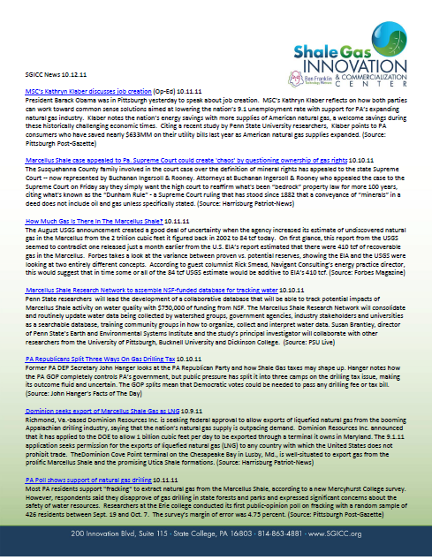
… Leading outreach
Producing a weekly newsletter summarizing news and journal coverage of Marcellus
Growing list of recipients leading to a strong and broad response from various stakeholders

Slide 6
Actions- Investments
March 2011 – Nittany Extraction Technologies
Fall 2011 – PSU/GOH/Mack CNG Engine conversion
Fall 2011 – PSU/ Little Pine Resources Mirco Grid in Clearfield County
Spring 2012 PSU/ CONSOL/HydroRecovery AMD Treatment
Assisting a start up company convert off the road vehicles to utilize LNG

Slide 7
Working closely with an Industry Expert Consultant(ADI ANALYTICS) to Identify Industry Needs
Addressed opportunities of Interest to the Shale Gas Companies in 4 areas:
Exploration
Drilling & Completion
Monetization
Right to Operate

Slide 8
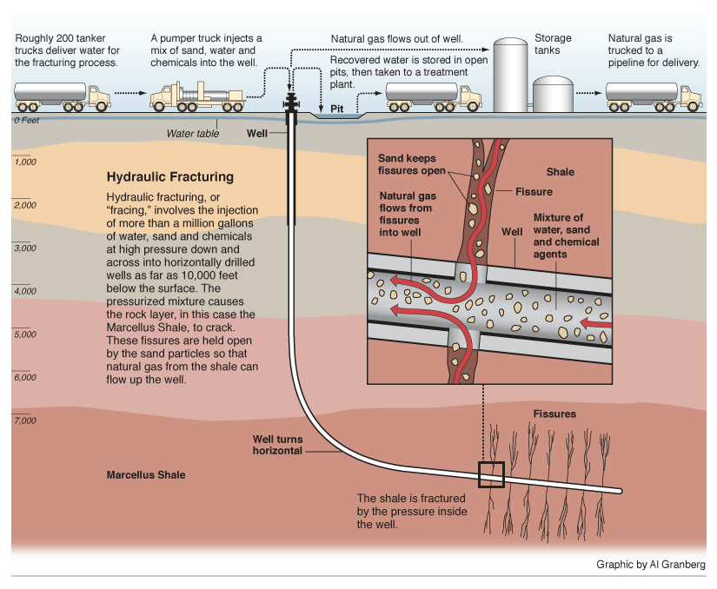
… With hydraulic fracturing being an enabling technology

Slide 9
Critical Needs Areas Analysis
Take Away From this Exercise….
Although the oil & gas industry has been around for a very long time, the shale gas play is new and revolutionary!
Opportunities for Innovation and New Product and Service Solutions are needed all along the value chain

Slide 10
… Our industry needs study has confirmed that companies in Marcellus have a number of innovation challenges
Major Innovation Challenges
Findings from industry study by ADI Analytics
Exploration
1
Ability to identify “sweet spots”
2
Improve predictive modeling capabilities
3
Develop tools for hydrocarbon characterization
Drilling & Completions
4
Develop faster, cheaper, and cleaner D&C technologies
5
Improve fracturing effectiveness with fewer non-performing fractures
6
Increase hydrocarbon recovery or reduce shale gas well decline rates
Gas
Monetization
and
Right to Operate
7
Increase attractiveness and adoption of natural gas-based transportation
8
Develop cheap and scalable natural gas conversion / utilization processes
9
Optimize water footprint through reduction, recycle, and treatment processes

Slide 11
The oil and gas value chain is driven by four major segments with Exploration and Production being key to shale gas …
Exploration
Production
Processing
Distribution
Leasing acreage and evaluating prospects for finding hydrocarbons
Drilling and completing wells in preparation of producing hydrocarbons
Treating and converting hydrocarbons to fuels and other products
Transport through pipelines and trucks to end-users
Early exploration
Seismic imaging (2-, 3-D)
Satellite imaging
Magnetic / gravity surveys
Region mapping
Drilling, horizontal drilling
Completions
Wireline logging
Well perforation
Artificial lift
Waterflood
Enhanced oil recovery
Oilfield chemicals
Conversion
Treating
Upgrading
Finishing
Liquefaction
Catalysts
Refinery chemicals
Blending
Biofuels
Fuel specs
On-site blending
Vapor pressure management

Slide 12
A wide range of jobs are necessary for drilling and operating natural gas wells in shale basins …
Job Type and Headcount for a Typical Gas Well
Sources: HIS Global Insight, ANGA, September 2009

Slide 13
Similarly, a wide range of equipment and materials is required for each natural gas well
Exploration
Production
Processing
Distribution
Data recorders
Drilling rigs
Equipment rentals
Truck transportation
Drilling rigs
Steel pipes and casing
Cutting and machine tools
Pumps
Compressors
Water and handling eqp.
Proppants, sand, and ceramics
Truck transportation
Tanks
Data recorders
Turbine sets
Power boilers
Heat exchangers
Tanks
Truck transportation
Steel pipes and casing
Compressors
Tanks
Truck transportation
Steel pipes and casing
Compressors

Slide 14
Some Examples of the Innovation Contest Ideas
Exploration – Concepts from….
a novel technique to perform airborne mapping of shale gas prospects to….
an all-digital visualization approach to traditional oil and gas exploration processes.

Slide 15
Some Examples of the Innovation Contest Ideas
Drilling & Completions – Concepts from….
Equipment weatherization concepts for shale gas operations taking place in harsh climates (like PA not Texas!) to….
Novel high temperature polymers for down hole use that provide chemical resistant coatings and linings for corrosion protection in fluid transfer components

Slide 16
Some Examples of the Innovation Contest Ideas
Monetization – Concepts from….
A new technology to extract and process heavy crude oil and tar sands from depleted wells and shale formations to…
An improved aftermarket Natural Gas and Diesel duel-fuel conversion kit for heavy trucks that is optimized for fuel economy versus increased power

Slide 17
Some Examples of the Innovation Contest Ideas
Monetization – Concepts from….
A process to make liquid fuels from natural gas
A new Compressor system to pump mixed fluids
Process to produce DME (synthetic fuel) from natural gas

Slide 18
Some Examples of the Innovation Contest Ideas
Right to Work – Concepts from….
A novel technology to separate the oil and other organic contaminants from the drill cuttings to allow potential secondary uses of the cuttings (other than landfilling) to…
A more sophisticated site selection process to identify and source fresh/ usable water for fracing that minimizes community and environmental impacts

Slide 19
Some Examples of the Innovation Contest Ideas
Right to Work – Concepts from….
Waste Water Treatment of Flowback water using a series of novel approaches
An adaptation of sophisticated military technology to provide self contained mobile power and telecommunications trailers with a variety of sensing tecniques

Slide 20
A couple more examples….
Novel Liner System for the well pads –
Current – HDPE based composite liner system
Seams welded on site; heavy (requires large equipment to place); leak proof? Can still be punctured; thrown away at end of drilling on that pad
Future systems – different material(s); light weight (installed by 2 men?); rugged (impenetrable?); reusable!

Slide 21
Another Example …
Long Haul Truck conversions to natural gas – What about the box trailer, and the trucker’s cab?
Need natural gas HVAC systems for REEFER/ Temperature Control boxes
Need properly sized natural gas generators and HVAC systems for the trucker’s sleeper cab for electricity and temp control
Need all of the systems to meet all of the regulatory requirements to be legal in all states
Need new testing equipment (and companies?) to test and certify these systems

Slide 22
So…. Where does the Supply Chain begin and end to support the shale gas play?
What we are finding - lots of folks have ideas and possible solutions all along the supply chain
Many are just looking for the entrance ramp in to the play
Others are looking for early stage investment in their ideas

Slide 23
In Closing….
Opportunities for Innovation & Commercialization exist all along the value/ supply chain
Role of SGICC?
Continue the conversation with industry, researchers, and entrepreneurs
host topic specific seminars, webinars, etc.
Continue to be a focal point for Innovation
Bridge the research/entrepreneurial gap to commercialization

