Slide 1
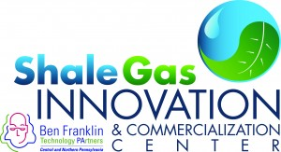
Shale Gas Innovation Contest Utility Locating and Leak Detection Optimization
Presented by: Morgan Abele, PULS, Inc.
For:

Slide 2
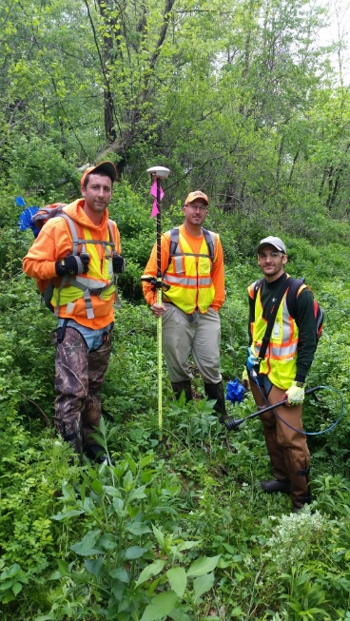
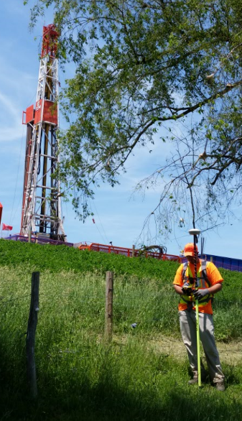
PULS – Who We Are
PULS specializes in the location, marking, leak detection, surveying and mapping of underground utility lines and structures including those for the oil and gas industry. The company provides a broad range of services including:
Electromagnetic (EM)
Ground Penetrating Radar (GPR)
Vacuum Excavation
CCTV Pipe Inspection
Leak Detection and Monitoring
Subsurface Utility Engineering
Utility Mapping
Project Planning Services
Innovation takes many forms. It can be new hardware or software, or it can be using existing technology in new or imaginative ways. This is the approach that PULS takes.

Slide 3
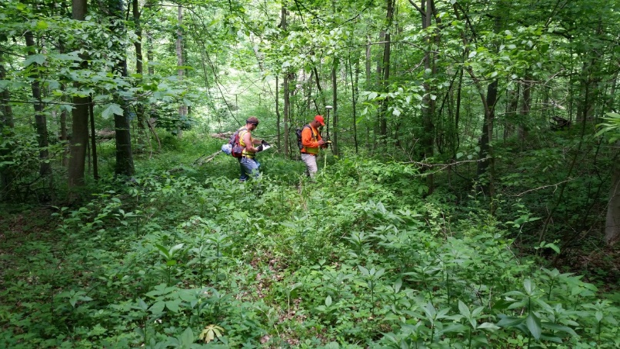
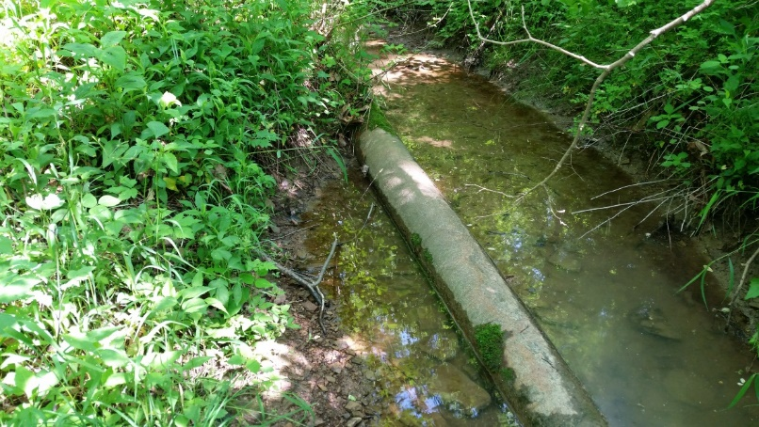
Shale Industry Issue: Fugitive Methane Emissions
Fugitive methane emissions are a continuing environmental and industry challenge.
Within Pennsylvania alone there are an estimated 100,000 miles of gathering systems - often undocumented and suspected significant source of fugitive methane emissions.
Equipment and processes that can find and document these system is critical to resolving the ongoing issues with fugitive methane emissions

Slide 4
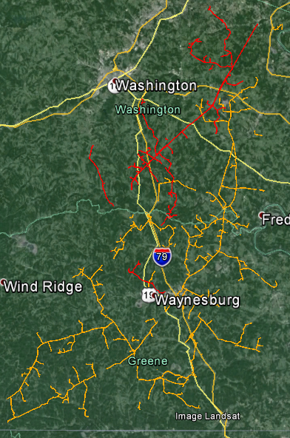
Case Study – Leak Survey
Natural Gas Gathering System
371 miles of pipelines spread over two counties in rural Pennsylvania
Oldest pipe dates from 1890’s
Very high lost and unaccounted for gas numbers:
4

Slide 5
The Results
Developed locating, leak detection and mapping process for gathering systems
Allowed for detailed analysis and costing
100,000’ linear removed from operation
Provided leak locations and classifications
Mapped over 350 miles of pipeline
Recorded over 1,800 leaks
Mapped over 22,000 data points
Most comprehensive GIS database within in the Marcellus Shale

Slide 6
Cost / Benefit
PULS was not the low bidder on this project.
PULS was selected because we redesigned the project to meet the needs of the company, not just a single department. PULS did this through understand what they client needed versus what they had requested in their original RFP. We built our proposal around those needs.
PULS worked directly with the client department to design a data collection process that could be completed in a single pass and provide all the information necessary to make a full assessment of the pipeline system and then make operational and fiscal decisions based on real data. As result:
100,000’ linear feet of pipe was abandoned due to analysis of PULS provided data, saving the client maintenance costs, lost product, and liability issues
Additional data provided the client with the ability to forecast the cost of:
ROW clearances
Future maintenance and replacement costs
Forecast potential failure locations
Forecast and allocate financial, material, and personnel requirements
It must be understood, that prior to this project there was not integrated and coherent means of locating, leak detecting and mapping of this type of low-pressure, conventional gathering systems. There is an estimated 100,000 miles of this type of pipeline in Pennsylvania, whose location and pipe condition is not known. It is suspected, that these systems represent a significant source of fugitive methane emissions. The methods and processes PULS developed for this project provides the means in which these pipelines can be assessed for both location and possible sources of methane emissions.
PULS cannot provide our pricing for this project in writing, but will provide to the judges verbally if asked. Pricing was reflective of particular needs of the client, condition of the right of way (we used machetes) and terrain and can be dissimilar for different clients in different locations.

Slide 7
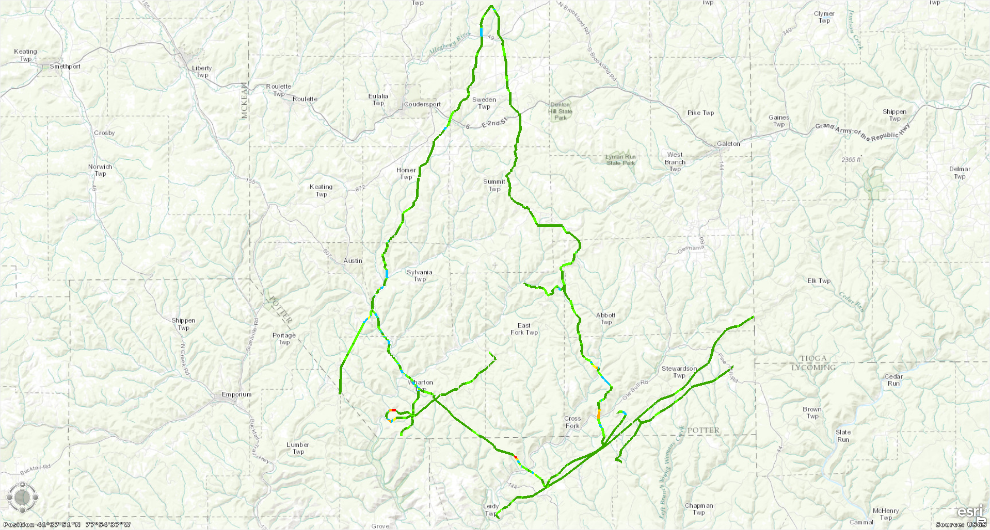
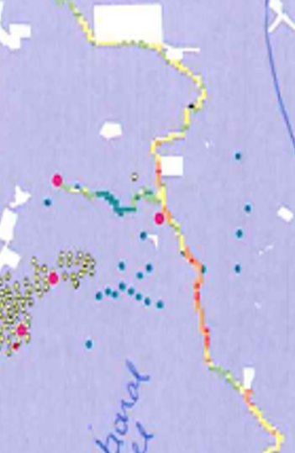
Case Study #2 – Fugitive Methane Emissions
Elevated Methane Levels in red and orange indicating possible leak on pipelines in easement.
Confirm location of leaks
Evaluate volume loss at found leaks

Slide 8
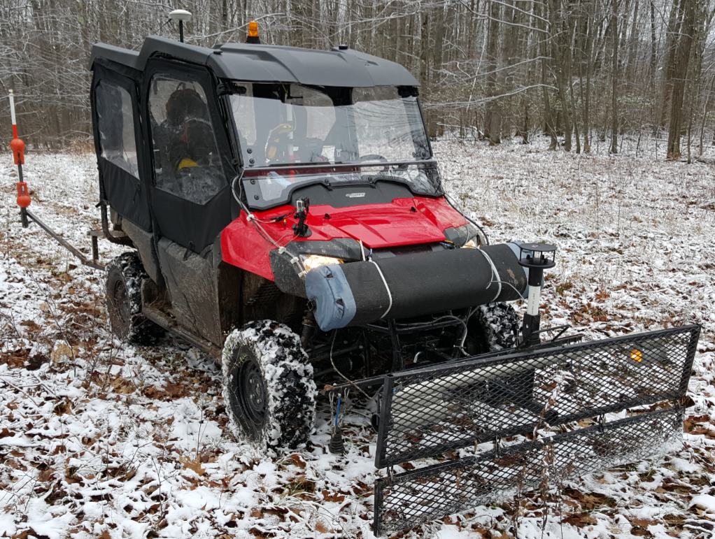
The Equipment
The equipment used for this project included:
Honda Pioneer 700-4 UTV
Modified with larger tires, long travel suspension and custom wiring harness/battery system
Utility Locating:
Optimal Ranging Spar 300 twin receivers
150 watt Vivax vLocDM transmitter
Trimble TSC3 Data Collector
Leak Detection:
Sensit, PMD Gas Detection System
Sensit, VMD Gas Detection System
Boreal Laser Gas Finder AB
FLIR Thermal Camera
GPS
Trimble GeoXH with Tornado external antenna*
*All equipment and data downloads were tied to together and geo-encoded.
.

Slide 9
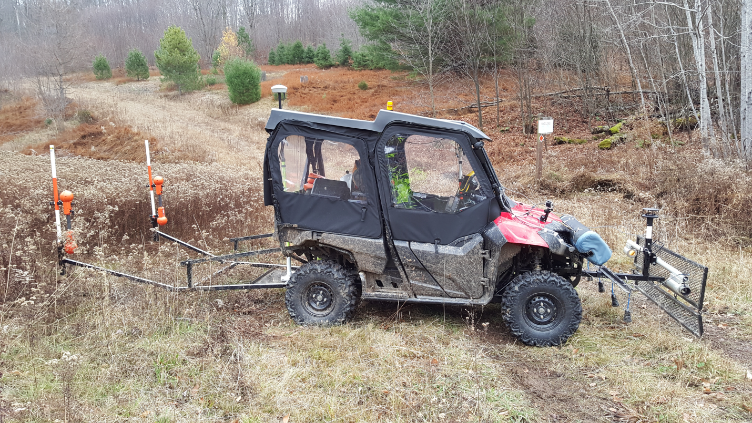
Equipment as Deployed
System was designed to minimize required customization and use as much existing hardware and software as possible.
Estimated cost of a production field unit would be approximately:
$72,000
Spar 300 Units
GPS Antenna
Boreal Laser
GasFinder AB
Sensit VMD
Honda Pioneer 700-4
Custom mounting systems, wiring, and software intergration
Sensit PMD

Slide 10
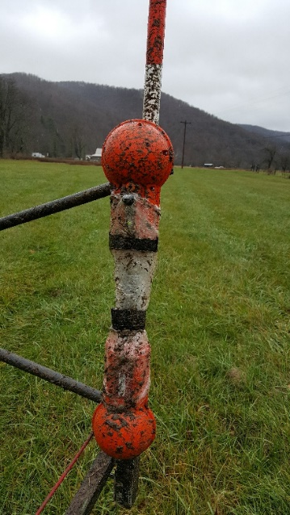
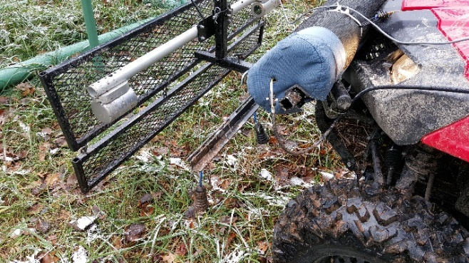
Project Outcome
290 miles off-road, leak detected and mapped over 85 miles of pipeline in 8 days.
Combined data from GPS, electromagnetic locator and three gas leak detection system into one integrated file.
Currently working with manufacturers of the equipment used on the project to make the equipment suitable for off-road use.
Redesigned Sensit PMD to protect against water intrusion and abrasion
Redesigned Sensit VMD to protect lenses from condensation/dust/debris, increase stability of mounting system and brackets, improve software processing to account for additional vibrations
Redesigned Optimal Ranging locating equipment to improve Bluetooth connections in extreme environments, designed protective covers for equipment, designed off-road mounting systems

Slide 11
Cost / Benefit
PULS was not the low bidder on this project – PULS was the only bidder. NETL could not find another bidder who could provide the equipment, personnel or expertise to meet the needs of the project.
Working with NETL, PULS designed the program, acquired and integrated the equipment, and then executed the program – all within the budget requirements set forth by NETL.
The systems was built as a both a proof of concept and as prototype off-road system.
This type of system did not exist prior to the NETL project, so it cannot be compared to any existing system. What can be compared is what it can offer:
A system of off-shelf-components that can be linked together to provide a means of rapidly locating, leak detecting and mapping of pipelines in cleared right of ways that are:
Too steep or rugged for traditional four wheel drive trucks or SUVs;
Newly seeded or sensitive to erosion from heavier vehicles or;
Is not practical for walking surveys.
Individual components can be easily replaced or upgraded, without having to replace or upgrade the entire system.
While airborne systems can detect areas with high methane concentrations, they cannot pinpoint the source of the methane. As this project shows, while the aerial methane survey determined that methane was in the right of ways, it was the ground based survey that confirmed it was not from the pipelines in the right of ways, but from an existing gas field.
This system provides pipeline owners a means to quickly identify or eliminate sources of methane leaks, without costly walking surveys and the associated risks.
A full production unit could be constructed between $50,000 and $70,000 per unit, depending upon the equipment and upgrades required.

Slide 12
Conclusion
The shale gas industry faces many challenges. This includes the ability of the industry to find existing pipelines and infrastructure for the purposes of maintenance and leak detection.
PULS has developed the equipment, processes and procedures, from readily available sources, which can be adopted by contractors and facility owners to locate, leak detect and map pipeline systems.
This gives the owners the ability to mitigate fugitive methane emissions and maintain their systems.

