Slide 1
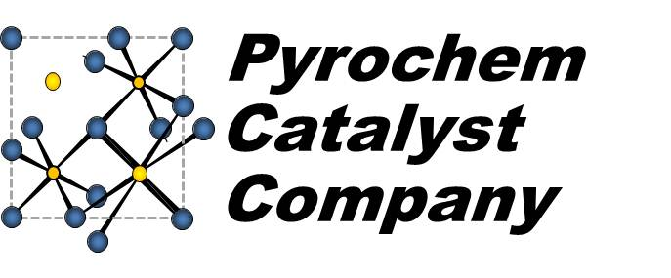
SHALE GAS INNOVATION CONTEST
May 7, 2013

Slide 2
Company Background
Company Incorporated the State of Delaware in May 2011
Exclusive License Agreement signed with NETL
US 8,241,600 Pyrochlore catalysts for hydrocarbon fuel reforming
US 8,133,463 Pyrochlore-type catalysts for the reforming of hydrocarbon fuels
Patent Applications filed in Europe, China and India
Six employees and advisors
Partnership with NETL for catalyst synthesis and catalyst testing
Seed Funding through Innovation Works
Alternate Energy Translation Grant Agreement
Innovation Adoption Grant Agreement
Angel Financing through Crimson Hill, LLC
Notes:
Overview of company

Slide 3
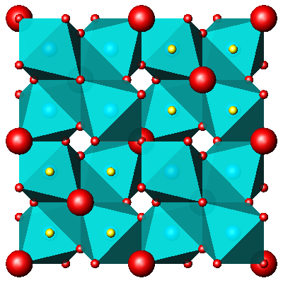
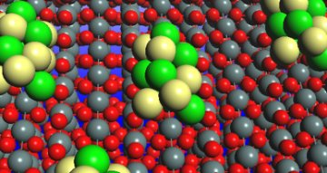
Technology Solution
THE PYROCHLORE TECHNOLOGY
Individual surface atoms in the PCC catalyst impart unique properties and require less precious metals
A conventional catalyst is formed with metal clusters sitting on a support surface
Notes:
Atomically-dispersed catalytic atoms yields very high activity and resistance to poisons
Long term activity for diesel reforming with excellent resistance to sulfur poisoning (fuel cell applications)
Extraordinary activity for natural gas reforming to hydrogen (refining applications)

Slide 4
Solution: Catalyst / Reformer Combination
PCC Pyrochlore Catalyst has unique properties that yield:
Unparalleled performance for converting hydrocarbons to syngas:
Partial Oxidation
Autothermal Reforming
Steam Reforming
Resistance to deactivation by carbon formation and sulfur poisoning
Stability at very high temperatures
Very low metal contents – atomic dispersion
A wide range of metal and promoter combinations for different reactions – partial oxidation, autothermal reforming and steam reforming of hydrocarbons
Notes:
What about efficacy at lower temperatures (setting up the potential to lower process operating temperatures?)

Slide 5
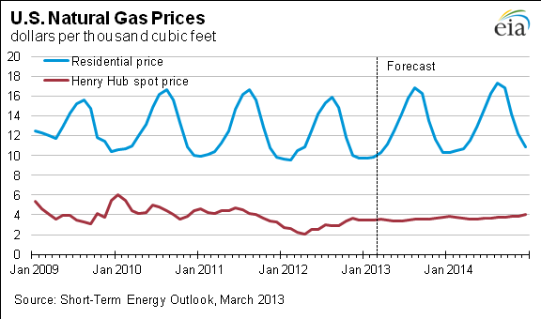
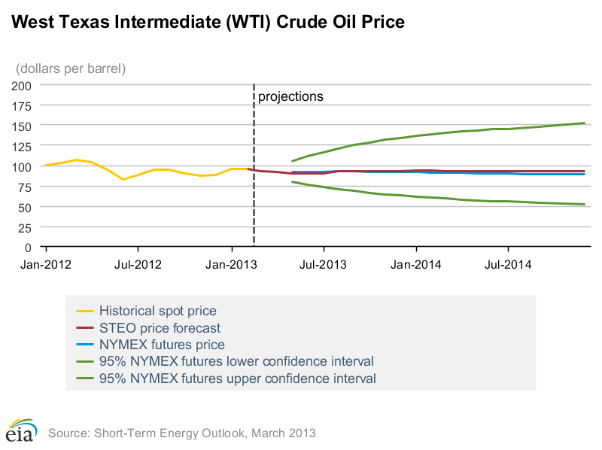
The Driving Force of Price Differentials between NG and Oil
$4,00/MCF = $23.20 BOE
$100/bbl creates a 4.2X price differential
Notes:
Market overview: Shale has caused a decoupling of NG and oil.
Question 1: Is this sustainable (operating technologies related to gas production and environmental remediation
Bottom-up (production related):
Water treatment
Controllers for better operations
Maintenance related technology
Leak detection
Question 2: How can we capitalize on this de-coupling
Focus on expanding markets for NG products

Slide 6
Price Differential Creates Opportunities
Gas Conversion to Fuel and Chemicals
Natural Gas
Refining
Wax
Syngas
Fischer-Tropsch
Hydrogen
Chemicals
Diesel/Kero
Fertilizers
Naphtha
Methanol
Fuel Cells
Light Gases
Formaldehyde
DME
Gasoline
Methyl Acetate
Acetic Acid
Ethylene Propylene
Polymers
Acetic Anhydride
Vinyl Monomer
Ketene
Esters
Notes:
NG as feedstock…

Slide 7
Hydrogen Market Opportunities
Hydrogen is essential to many refinery and chemical processes
Refining
Global demand 30 million tons hydrogen / year
Upgrading of diesel and gasoline
Sulfur and metals removal from petroleum
Chemicals
Global demand of 25 million tons / year
Ammonia
Hydrogenation of Fats / Oils
Metallurgy
Strong growth in refinery and chemical hydrogen generation catalysts* :
Catalyst market $1.2 billion
CAGR: 6.3% (2011 – 2018)
Market dominated by
Johnson-Matthey
BASF
Haldor-Topsoe
Air Liquide (hydrogen)
* Wintergreen Research Inc.
Drivers for increased hydrogen demand**
Focus on efficiency and cost reductions
Heavier crudes
Cleaner fuels
Changing trends in fats/oils hydrogenation
* * IHS Research
Notes:
Where is Sud Chemie?

Slide 8
Specific Project: Making Syngas from NG and CO₂
CO₂ is Greenhouse Gas produced through oil/gas recovery and by conversion processes
Many conversion processes generate excess heat and CO₂
especially methanol and Fischer-Tropsch
Need an integrated system that balances heat and CO₂ production in conversion processes to maximize efficiency and lower cost
Excess heat can be used for reforming natural gas with carbon dioxide
However, carbon formation and operability problems limit the ability of conventional technology/catalysts to reform methane with CO₂
Reformers are the most capital intensive component of conversion processes.
Notes:
Our catalyst can handle the higher temperatures and higher carbon content. This leads to:
- Re-capture of excess heat
CO2 recapture
Both with a lower cost catalyst.

Slide 9
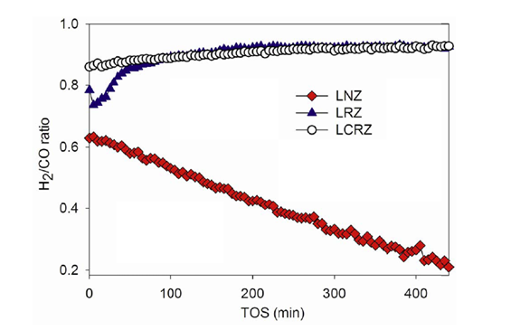
Validation of the Concept
Typical Catalyst
750 C, 24,000 hr⁻¹ GHSV
From Master Thesis of Sarthak Gaur, Louisiana State University, Dept. Chemical Engineering, May 2011
Notes:
PCC work (conducted at LSU)..
Dry reforming with CO2
Red dot line is typical traditional catalyst

Slide 10
Efficient Utilization of Process Heat
NG
O₂
Conversion Process
Syngas
Reformer
NG Partial Oxidation and Conversion Process generate heat
CO₂ Reforming requires heat
System is balanced consistent with the Conversion Process
CO₂
Separation
Products

Slide 11
Project Activity
Scoping Study
Using a simple fixed bed reactor with single PCC catalyst , evaluate a matrix of NG: O₂ : CO₂ ratios measuring resultant syngas ratio, catalyst longevity and carbon formation
Evaluate a graded bed reactor with partial oxidation catalyst followed by the PCC pyrochlore catalyst under the same matrix of feed compositions as #1.
Design small cross-flow and counter-flow channel reactors using partial oxidation catalyst separate from PCC pyrochlore catalyst
Objective—Validation of Reformer Concept
Conversion targets reached
Lifetime performance established through accelerated testing
Projected cost savings refined
Notes:
Will combined reforming generate long term sustainable performance at desired syngas ratios ?
What are the optimum NG : O₂ : CO₂ ratios?
If the reactions must be separated, what is the best reformer design?
What product will we be making?

Slide 12
Projected Use of Funds
Activity | Grant $ | Company $ | Total $
Catalyst Optimization | $3,000 | $9,000 | $12,000
Concept Feasibility
- Review CO₂ test conditions | $6,000 | $10,000 | $12,000
- Confirm lifetime stability | $6,000 | $4,000 | $8,000
Reformer Design Work | $10,000 | $2,000 | $14,000
TOTAL | $25,000 | $25,000 | $50,000
Notes:
Will combined reforming generate long term sustainable performance at desired syngas ratios ?
What are the optimum NG : O₂ : CO₂ ratios?
If the reactions must be separated, what is the best reformer design?
What product will we be making?

Slide 13
Summary
Patented technology that atomically embeds metal catalyst into a crystal lattice
Makes existing NG reforming applications better by:
Lowering catalyst costs by using less metal (especially important in precious metal catalyst applications)
Operating at better oxygen to carbon ratios (extreme refractory properties / high temp stability)
Resistance to poisoning (carbon / sulfur)
Unparalleled longevity
Opens new markets that were not possible with legacy catalyst technology
Fuel Cell applications
The reforming of NG into syngas with beneficial reuse of heat and CO₂
Notes:
Will combined reforming generate long term sustainable performance at desired syngas ratios ?
What are the optimum NG : O₂ : CO₂ ratios?
If the reactions must be separated, what is the best reformer design?
What product will we be making?

Slide 14
Contact Information
Steve Gallo:
sgallo@pyrochemcatalyst.com
919-491-0913
Jeffrey Harrison:
jbharrison@pyrochemcatalyst.com
919-349-7145
Our Appreciation and Thanks to the Shale Gas Innovation Center and Contest Sponsors

