Slide 1
Custom laser cladding solutions for the toughest industrial problems
Drew Nissly – President www.Nittanylasertech.com
Notes:
I am very excited to introduce you to Nittany laser technologies.
Our mission is to provide custom laser cladding solutions for the toughest industrial problems.
One of the problems that our customers have is corrosion and wear

Slide 2
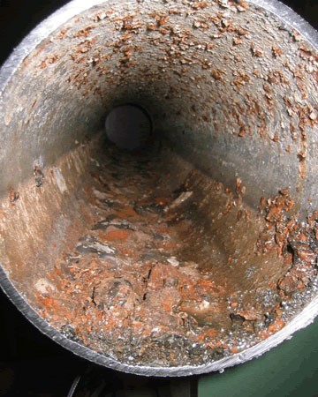
Problem: Shale gas drilling equipment is subjected to extreme environments which cause corrosion and wear damage
Corrosion
Wear
frac heads
drill pipe
trans-portation pipeline
drill bits
drill pipe
ST-80 jaws
$7B spent annually to repair corroded oil & gas pipeline
$2B global market in pipe cladding
Expected to double in the next 4 years
2
Notes:
As I am sure you know, Shale gas drilling equipment and pipeline is subjected to extreme environments which cause corrosion and wear damage. Acidic gas in the shale deposits and many moving parts in the drilling equipment cause it to wear out prematurely leading to costly repairs and replacements of parts like frac heads, drill pipe, and transportation pipeline. 7 Billion dollars is spent anually to repair corroded oil and gas pipeline alone. It is estimated that there is a 2 billion dollar market for pipe cladding, which is expected to double over the next four years.

Slide 3
Drawbacks of traditional cladding technologies for corrosion and wear protection
Plasma Spray Coatings:
Porous
Poor bonding with the base metal
Prone to cracks and chipping
Arc Cladding (TIG or MIG):
High heat input process, lots of dilution (mixing of the clad layer with the base material)
Poor thickness control
Pre-heating often required
Time consuming
Dilution
Laser cladding
Arc cladding
3
Notes:
Two traditional cladding technologies that are used for corrosion and wear protection are Plasma spray and arc cladding. While these methods do provide a level of protection they also have their drawbacks. Plasma spray coatings are porous and poorly bonded to the base metal. This makes the clad layer prone to cracks and chipping. Arc cladding produces a more robust clad layer, however, it is a high heat input process, which causes distortion of the part, and dilution (or mixing of the base metal and the clad layer. Additionally there is poor thickness control, preheating is often required and it is time consuming.

Slide 4
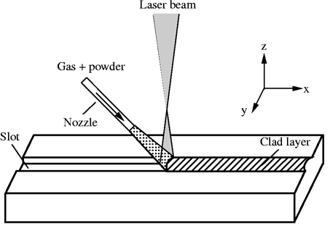
Solution: Laser Cladding – Depositing a thin layer of highly corrosion- or wear-resistant material where it is needed.
100% dense full metallurgical bond
1/6th the heat input of arc cladding
Wide material selection
Accurate thickness control
Thinner clad layers without sacrificing material properties
Extends part life by 2-10X
4
Notes:
Laser cladding is the deposition of a thin layer of highly corrosion or wear resistant material where it is needed.
By laser cladding a part it’s life can be increased by a factor of 2 to 10 times.

Slide 5
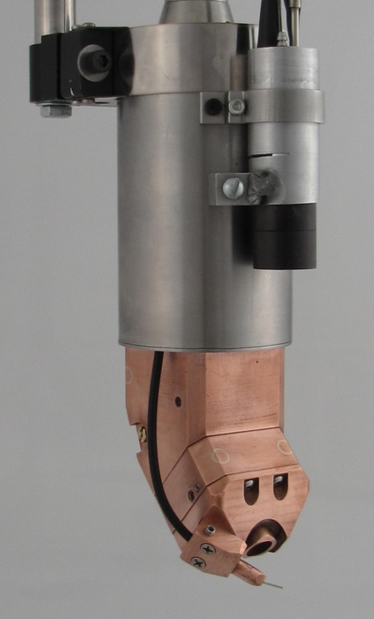
NLT’s Product Line – Deep Bore Clad Heads
2”, 3 kW 4”, 4 kW 6”, 10 kW
Reliable – undergone 100’s of hours of testing
Robust – designed for repair of Navy submarine valves
Compact – can repair areas other tools can’t
Versatile – clads small internal features and external surfaces
5
Notes:
Nittany Laser Technologies offers a product line of deep bore laser cladding heads in several size and power options. Our products have undergone hundreds of hours of testing and have proven to be robust, reliable and versatile tools.

Slide 6
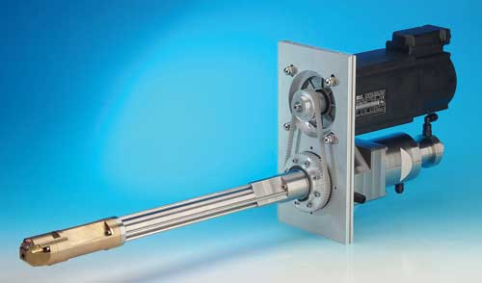
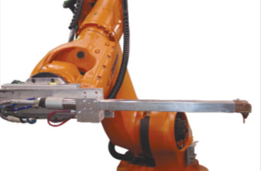
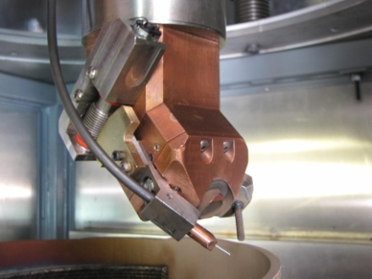
NLT’s clad tool compared to the competition
Deposition
Rate
(grams of alloy/min)
6
Notes:
There are two main competitors to our cladding tool, one by Pallas and one made by Fraunhofer. Our cladding tool has is rated at a higher maximum power, which gives us a higher deposition rate than the competition, allowing the customer to clad faster. Additionally, while the competitors can only clad with powder filler material our clad head can use either powder or wire filler material

Slide 7
NLT’s clad tool compared to the competition
Deposition
Rate
(grams of alloy/min)
6
Notes:
This allows us to not only use a wider range of materials, but it also enables us to preheat the wire.

Slide 8
NLT’s clad tool compared to the competition
Only NLT’s tool works with wire or hotwire!
Deposition
Rate
(grams of alloy/min)
6
Notes:
This hotwire process increases the maximum deposition rate by a factor of 2 to 3, giving us an overall deposition rate of 4 to 5 times greater than the competition.

Slide 9
Cladding deep bores
Reach
Reach (inches)
7
Notes:
Another key advantage of our clad head is it’s compact design. The competitors products have a short arm attached to a larger body, and so their tools are limited in their reach by the length of the arm.
The NLT clad head is designed so that the entire tool fits inside a 4” diameter. This allows the NLT clad head to reach almost 10 times further down the inside of a bore than the competition. This means that only our product has the ability to clad the inside of long pipe

Slide 10
NLT Laser Cladding Advantages -
Only NLT’s tool can clad the inside of long pipe
~ 33% increase in deposition rate over arc cladding (with 10 Kw tool and hotwire)
50-66% reduction in clad material required
Better corrosion and wear resistance
Part life can be extended by 2-10X
Longer part life reduces cost associated with repairs
8
Notes:
For example, we are talking with a very large cladding company based in Dubai about developing a high power hotwire cladding head for cladding 20 foot sections of oil pipe.

Slide 11
Cladding Costs-
Material Cost
$1/Square Foot for stainless steel
$6/Square Foot for nickel based alloys
1mm thick clad layer
Laser Processing Cost
$1.60/Square Foot
$55/hr for electricity, maintenance, consumables, operator cost and machine amortization @ 35 ft²/hour clad rate.*
Example: Cost to clad inside and outside of 6” diameter 30’ long pipe with Stainless Steel
Material Cost + Laser Processing Cost = $94 + $136 = $230
9
* Assumes $600,000 capital cost amortized over 5 years and 4000 hours/year laser use

Slide 12
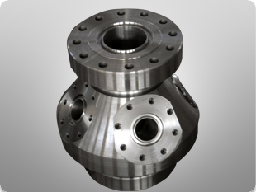
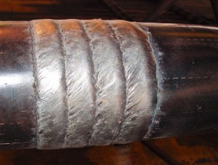
Applications in Marcellus Shale
Drill pipe thread repair
Drill pipe hard-banding
Pipeline corrosion protection
Frac head repair
ST-80 Jaw repair
10

Slide 13
Company Profile
S – Corporation started in 2012
1 full time employee
2 Vertical machining centers
1 Fanuc 5 axis robot
2000 sq ft industrial/office space
$40,000 revenue in 2012
$55,000 revenue in 2013 (Jan 1 – April 1)
Revenue Sources:
Tool Sales: $30-90K/tool
System Design and Installation: $250K–1M
Consulting and Parameter Development
11
Notes:
Our second revenue source will be through the sale of turnkey cladding systems, which include the laser, robot and cladding tool.
We are currently working with a customer that has 3 sets of different “non weld-able” parts requiring repair. We are working to design and integrate a cladding system to repair these 3 parts. NLT will deliver the system and train the user.

Slide 14
Path Forward
NLT is currently raising $100K to purchase a high power laser ($50K personal investment, $50K outstanding). This will allow NLT to offer laser cladding services for repair of damaged components or protective coating of new components.
NLT is developing partnerships with a major welding equipment supplier and worldwide pipe cladding company to test and market our products.
12
Notes:
In conclusion, there is currently an unmet market demand for laser cladding tools.
Nittany laser technologies provides robust cladding tools that work faster and are more versatile than the competition.
We are currently pursuing several strong customer leads, and we are very excited and optimistic the success of Nittany Laser technologies!

